Slide 1
Decision Trees with R
Anurag Nagar

Slide 2
rpart package
Install using:
install.packages("rpart", dependencies=TRUE)
To load the package, use the following:
> library(rpart)

Slide 3
Loading data from files
Read files using the following command:
> read.table(file, header = FALSE, sep = "", quote = "\"'",
….)
e.g.:
f<-read.table(file = "training_set.csv",header = TRUE, sep = ",")
To see individual attributes, you can use the $ sign:
f$XB
f$Class
…
You can convert these to factors as:
t <- factor(f$Class, levels=0:1, labels=c("Yes","No"))

Slide 4
Using available data from package
> data(stagec)
> stagec
To see all data available in a package, use the following command:
data(package="rpart")
You can see the structure of data by using:
> str(stagec)

Slide 5
How to create DT model
Most important function is rpart.
You can see help by using the ? operator:
?rpart
The key is to write a correct formula in R format:
Dependent ~ Independent1 + Independent2 + …
e.g.:
y ~ x1 + x2 + x3 …
In terms of machine learning, it would be:
Class Label ~ Attribute1 + Attribute 2 + …

Slide 6
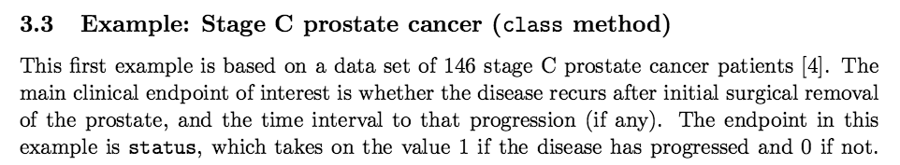
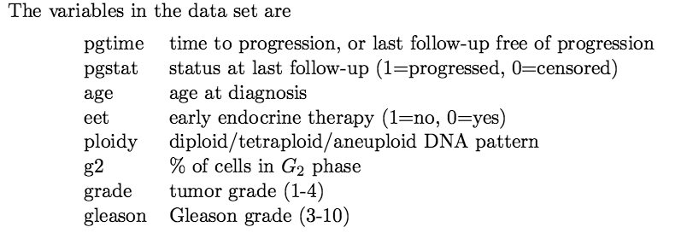
Example

Slide 7
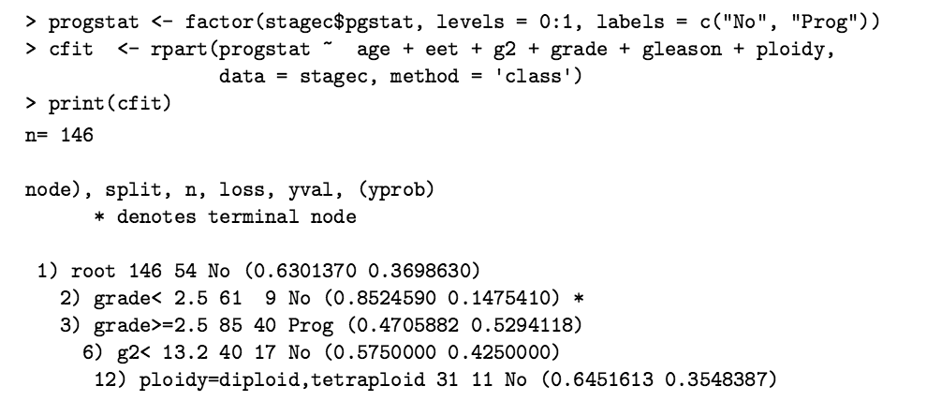
Example

Slide 8
Example
To get a nice looking tree plot, you need to output the plot +
the text
> par(mar = rep(0.1, 4))
> plot(cfit)
text(cfit)
summary(cfit)

Slide 9
How does split happen?
mytree <- rpart(Fraud ~ RearEnd, data = train, method = "class", parms = list(split = 'information'), minsplit = 2,
minbucket = 1)
Note the parms parameter.
By default, split is on Gini Index.
If you want to split on Information gain, need to specify it in the parms list as shown above

Slide 10
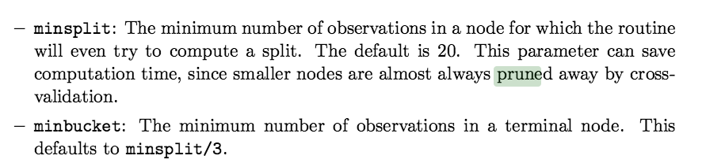
How does split happen?

Slide 11
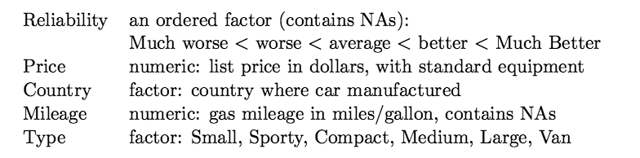
Car dataset

Slide 12
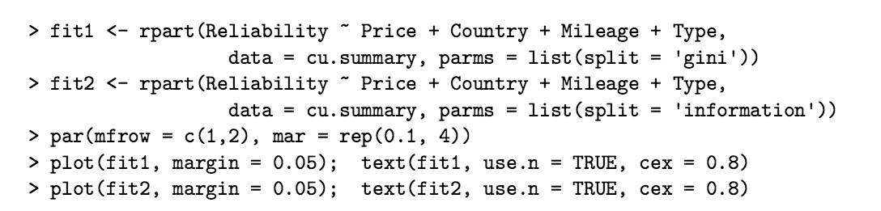
Car dataset

Slide 13
Plot the tree
To get a nice looking tree plot, you need to output the plot +
the text
> par(mar = rep(0.1, 4))
> plot(cfit)
text(cfit)
summary(cfit)

Slide 14
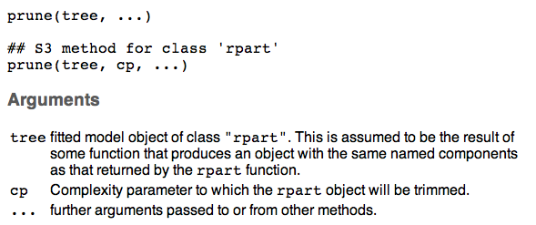
Prune the tree

Slide 15
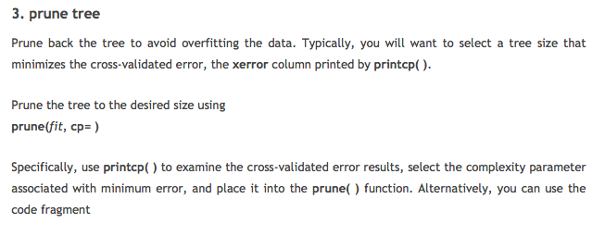
Prune the tree

Slide 16
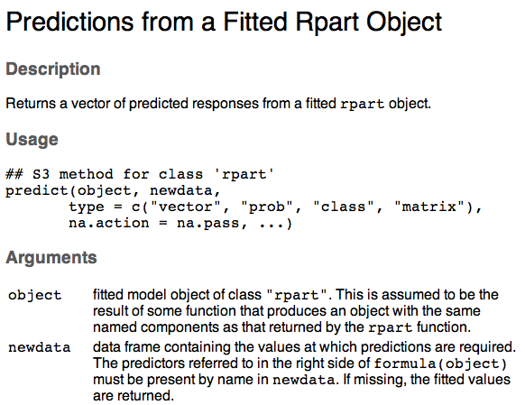
**Prediction on test data**

Slide 17
Prediction on test data
https://stat.ethz.ch/R-manual/R-devel/library/rpart/html/predict.rpart.html

Slide 18
Class Assignment
Look at the following two datasets from rpart:
kyphosis
solder
Find the best tree, provide its summary, plot.
Find the best complexity parameter for pruning.
Submit your R code via eLearning.

